Slide 1

CMPS270 PROJECT - Battleship Game : Introduction
This presentation delves into the development of a console-based Battleship game, exploring its core features, design challenges, and key improvements. Battleship is a traditional strategy game that dates back to before World War I and was later commercialized as a popular board game by Hasbro. The primary objective of the game is to sink all of the opponent’s ships. This project supports two modes: Player vs. Player (PvP) and Player vs. Bot (PvB), offering a strategic and engaging gameplay experience.

Slide 2
PvP Mode: Player Interaction
In the PvP mode, players take turns placing their ships then making moves by providing coordinates for their attacks. The game processes these moves, updating the game grid to reflect hits, misses, and sunk ships. This mode relies heavily on user input handling and precise execution of game updates based on player actions and choices.
Player Input
Game Logic
User Interaction
Players provide coordinates for their attacks.
The game processes moves, updating the grid to reflect hits, misses, and sunk ships.
The game provides feedback on each move, ensuring a smooth and engaging gameplay experience.

Slide 3

PvB Mode: Introducing BOT
The PvB mode introduces an AI-controlled bot called BOT that uses advanced strategies to challenge the player. The bot's logic is built around the same foundational functionality as the PvP mode, ensuring consistency in the game mechanics. However, the bot employs additional features, such as a FIFO (First-In-First-Out) queue to track unexplored cells near hits:
1
FIFO Queue
2
Hunt Logic
3
Strategic Moves
The bot uses a FIFO queue to track unexplored cells near hits, allowing it to efficiently hunt down ships.
The bot prioritizes cells in the queue, "tailing" the hit until it sinks the ship.
The bot strategically uses radar and smoke moves to gain an advantage.

Slide 4
Challenges Faced: Bot Design and Balancing
1
Initial Approach
Using last hit coordinates for basic moves, but this approach fell short for larger move areas.
2
Queue-Based System
Transitioning to a FIFO queue resolved the limitations of single-hit tracking, allowing for more efficient handling of larger move areas.
3
Bot Balancing
Balancing the bot's use of radar and smoke moves was another challenge, as the bot sometimes relied too heavily on scans early in the game. Handled with dense clusters and move checkers

Slide 5
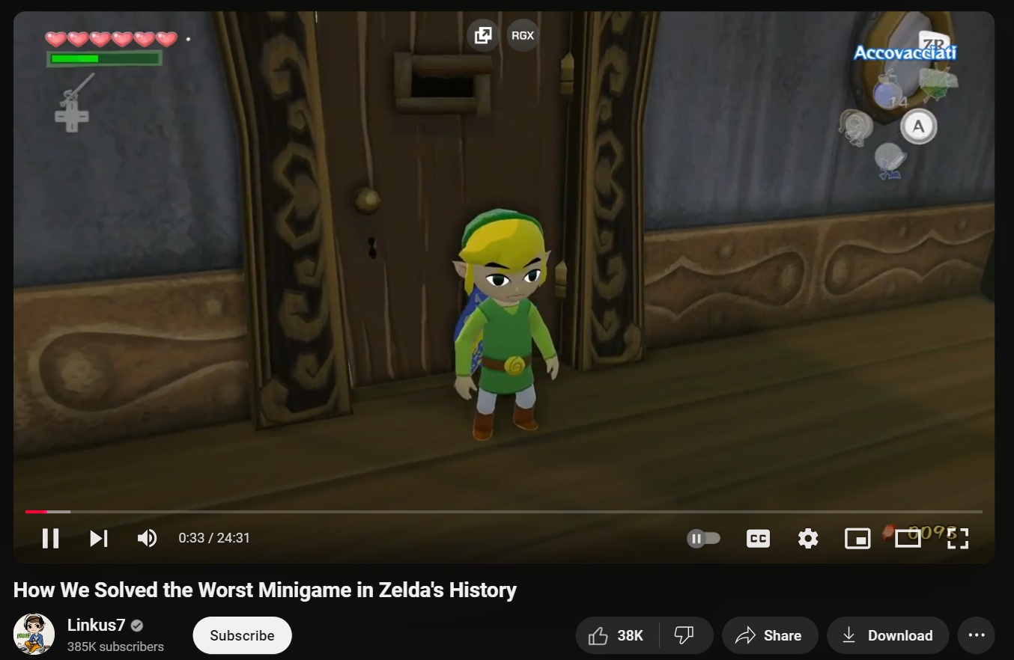
The Inspiration:

Slide 6
Resolutions: Leveraging External Resources and Refinement
Hunt Logic
Radar Balancing
Smoke Placement
The hunt logic adapted from external resources allowed for more sophisticated bot strategies.
Introducing randomness, threshold checks, and usage constraints for radar moves made the bot more balanced and unpredictable.
Prioritizing vulnerable high-density clusters significantly improved the bot's defensive potential.

Slide 7




Limitations and potential Improvements
Heatmap Approach
Could improve the bot's move efficiency by identifying high-probability areas for attacks.
Smoke Placement
Could be improved by considering potential future threats.
Adaptive Memory
Could significantly improve the bot's performance by allowing it to learn from past moves.

Slide 8
Thank you for your time and attention! ^-^

